Slide 1
Cancer Biology Biol 445
Spring 2020
Dr. Heidi Super
Lecture 27
4-15-2020

Slide 2
Announcements
Quiz 4---Please check blackboard for your scores and my comments. Please let me know if you can’t see something---I gave scores for each question and comments on most answers. You should see more than just an overall score.
Please email me to discuss any questions you may have. I’m happy to have a second look.

Slide 3
Where were we?
We had wrapped up ionizing radiation---how it damages DNA and it’s mutagenic properties make it a potent carcinogen.
I had omitted an interesting source of ionizing radiation---so let’s return.

Slide 4
Just a last word on ionizing radiation
Recall different radioisotopes emit different types of radiation---and alpha () radiation is the most damaging to biological tissues.
But α is also the least penetrating to biological tissues. It is only only harmful when ingested or inhaled.

Slide 5
Radon is a radioactive gas, which is produced when radium decays, which is produced when decays! uranium
Radon is easily inhaled. Radon emits α particles and changes to polonium. Polonium is a radioactive metal, that once inside the lungs continues to emit α particles.

Slide 6
So…exposure to radon is linked to lung cancer.
☹ North Dakota has some of the highest levels of Radon in the country . (fig 6-8)
Radon/polonium also end up in tobacco leaves that, when smoked, expose the lungs to α particles.

Slide 7
Radium
An interesting and tragic discovery was made after radium was found to make paint luminescent (glows in the dark).
Radium paint was routinely use to paint watch dials to make them visible in the dark.
The workers who painted were mostly women who often use their tongues/mouths to wet the brush an make the tip pointed

Slide 8
Radium is chemically similar to calcium and becomes concentrated in bone tissue.
Some of the women suffered acute radiation sickness---anemia, and necrosis of bone including jaw.
Some contracted bone cancer

Slide 9
Read more!
https://en.wikipedia.org/wiki/Radium_Girls
Several books
Play—”Our shining lives” was performed at MSU in 2015!

Slide 10
Finally….
A reminder, that we cannot avoid some level of radiation, both UV and ionizing. There are many natural sources. ~80% of our exposures come from natural sources.
Linking radiation to disease requires normalizing to normal exposure—Background Equivalent Radiation Time (BERT)
See Table 6-3

Slide 11
Where were we…continued?
Cancer detection
What is cancer screening? How is it different from a procedure like a biopsy?
What is the ultimate goal of cancer screening?
Give some examples of cancer screening procedures.

Slide 12
Colon cancer screening
What are 3 ways to screen for colon cancer?
How does each work?
At home, fecal tests (collection at home), have made colon cancer screening easier and less complicated than in the past

Slide 13
Signs of colon cancer in feces—presence of blood or DNA with mutations
Fecal examination fecal occult blood test—FBOT or fecal immunological test --FIT
Identifies blood in feces---an abnormal condition that may indicate colon cancer—collection done at home. Sample dropped off at local lab.
Gene testing on cells found in feces—Looking for APC mutations!

Slide 14
New paper linked next to lecture link.
Discusses fecal DNA analysis---Really interesting what can be done to detect mutations in genes you have studied--from cancer cell DNA sloughed to feces.
Cologuard even tests for epigenetic changes in target genes.

Slide 15
Epigenetic changes?
No change in the DNA sequence itself, but a chemical modification of the regulatory sequences of the DNA changes how much transcription takes place---so ultimately how much protein is produced from that gene.
i.e. Addition of methyl groups to promoter of genes usually inhibits transcription of that gene.

Slide 17
Summary
Tests that find polyps and cancer
Flexible sigmoidoscopy every 5 years*
Colonoscopy every 10 years
Double-contrast barium enema every 5 years*
CT colonography (virtual colonoscopy) every 5 years*
Tests that mainly find cancer
Guaiac-based fecal occult blood test (gFOBT) every year*,**
Fecal immunochemical test (FIT) every year*,**
Stool DNA test (sDNA) every 3 years*
*Colonoscopy should be done if test results are positive.
** Highly-sensitive versions of these tests should be used with the take-home multiple sample method. An FOBT or FIT done during a digital rectal exam in the doctor's office is not adequate for screening.

Slide 18
Educating the public
After the death of her husband, Jay Monahan, Katie Couric made the nation more aware of the disease and its prevention. She agreed to have her colonoscopy televised!
http://www.youtube.com/watch?v=15JsYSZIT-Q
Later---Homer Simpson agreed too!
http://www.youtube.com/watch?v=6uPu1dRRfTY

Slide 19
Both videos are were produced for organization led by Couric and many celebrities---Stand Up To Cancer
http://www.standup2cancer.org/

Slide 20
Screening by blood tests--immunodetection
Blood samples can be analyzed for tumor-specific antigens
e.g. Prostate specific antigen (PSA), now a routine screen for men to screen for prostate cancer.
PSA is not tumor-specific, but produced in very low levels in men with normal sized prostate

Slide 21
Cancer research includes continuous search for tumor-specific molecules
Why?
New, more specific screening/diagnostic tools
Molecular targets for therapy---always trying to limit damage to normal cells while killing cancer cells
Monitoring effectiveness of treatment.
Assaying minimal residual disease--MRD.

Slide 22
New paper linked to website---analyzing blood for circulating tumor cells or for tumor-specific free (outside of cells) DNA in blood.
Think about gene alterations you’ve learned about. How might you design a test for MRD for a specific cancer type?

Slide 23
Many/most types of cancer completely rely on molecular analysis for diagnosis and treatment plan.
Even with one tissue, dozens of types of cancer may occur.
There are at least 8 subtypes of acute myeloid leukemia, many with consistent recurring gene alterations.

Slide 24
Another example Breast cancer is not one disease
Breast tissue consists of MANY cell types and cancer can occur in any of the types.
Among the cancer cells, they may differ greatly in gene expression/gene alteration
Estrogen Receptor positive
HER2 positive
Progesterone positive
OR
Triple negative breast cancer

Slide 25
Each type of breast cancer will have a different plan of treatment based on the cell surface molecules expressed (or not expressed).
How does one discover a tumor-specific molecule? What are some of the methods?

Slide 26
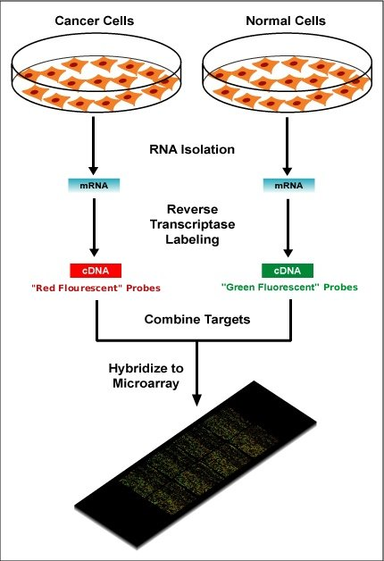
Methods
Gene expression analysis
Compare gene expression in tumor cells with normal tissue of the same type
Common assay = DNA or protein microarray
Tests thousands of genes simultaneously to compare expression in normal and abnormal tissue.
Sometimes referred to as gene expression profiling.

Slide 27
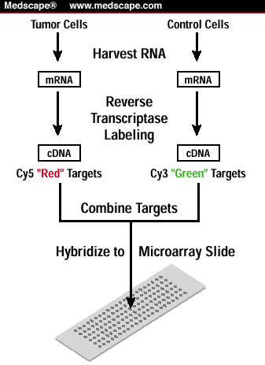
20-40,000 genes represented here

Slide 28
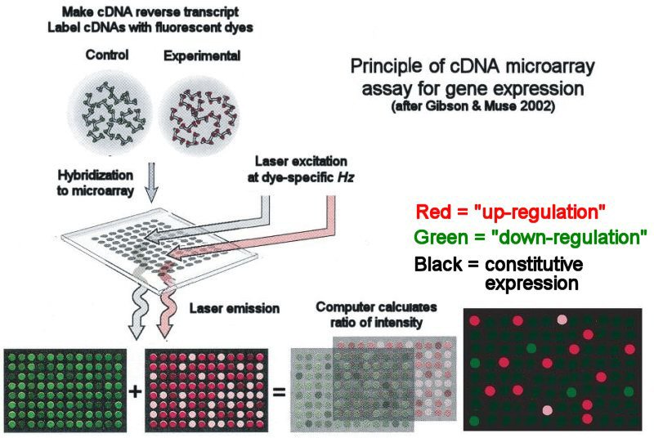
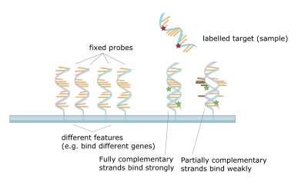
Yellow= equal expression
Black = no expression
Figure after Gibson & Muse 2002; text material ©2008 by Steven M. Carr

Slide 29
Red spots indicate genes that are expressed at a higher level in the tumor cells (potential tumor antigens)
Green spots indicate genes that are expressed at lower levels in tumor cells. (potential tumor suppressor genes)

Slide 30
Similar analysis for proteins
Detection of differentially expressed proteins using antibodies.
Proteomic screening (Figure 11-3)

Slide 31
These techniques are expensive and difficult to interpret/verify. NOT PRACTICAL for everyone to have extensive gene expression analysis, even if they have a confirmed tumor.
However, many such analyses, have led to testing for a smaller number of potentially relevant genes for some cancer types.

Slide 32
Gaining ground…NGS
Actually, microarray is becoming less popular and direct DNA sequencing is becoming more common.
Technologies collectively know as Next Generation Sequencing (NGS) allow whole genomes to be analyzed for cancer specific genetic changes.
Still expensive and not standard of care.

Slide 33
Some genetic testing---of a smaller collection of genes---is more commonly performed for specific cancer types.

Slide 34
Oncotype DX—breast cancer
A genetic test developed from lots of gene expression analysis experiments
Looks at a relevant set of 21 genes, to predict recurrence probability in breast cancer.
Older types of analysis (or lack of analysis) would over-treat some breast cancer and under-treat others.

Slide 35
Since I last taught this course, Oncotype DX tests have been developed for colon and prostate cancer too!
https://www.oncotypeiq.com/en-US
https://www.genomichealth.com/en-US/oncotype_iq_products/oncotype_dx.aspx

Slide 36
These tests (and others like them) use scores based on genotypes/specific gene expression:
1. to predict recurrence of cancer after standard treatment—and thus make informed decisions on more aggressive treatment.
2. to predict the response of a patient to specific types of therapy/drugs

Slide 37
Examples---various cancers…
Lung cancer drug---Iressa
Works in only ~10% of patients, but in patients with specific EGF receptor mutation it is extremely effective.
Genetic testing may mean a cure for more patients, and avoiding a useless treatment for others.
…More specific drugs later

Slide 38
Tests like the Oncotype tests belong to a set of newer approaches to health care called ”precision medicine”. In gereral it uses DNA/gene analysis to predict risk for diseases, intervention and treatment responses.

Slide 39
Cancer treatment
Surgery---oldest cancer treatment---still important. In many cases radiation or chemotherapy can only be successful if the tumor size is reduced in size.
Surgery has had an interesting history. I highly recommend reading the Emperor of All Maladies. (Also PBS special)

Slide 40
At one time, surgery was really the only “treatment” for cancer.
i.e. mastectomy removes obvious tumor tissue as well as normal tissue. Surgeons knew, complete removal of all cancer cells was tricky---so “radical mastectomy” became common. (This left a woman without lymph nodes, muscle, connective tissue. Disfiguring, life changing, and without much reduction in recurrence of the cancer) ☹

Slide 41
Alternatives to traditional surgery
Lumpectomy rather than mastectomy or other full removal of breast.
Laser surgery
Cryosurgery
Electro surgery
Ultrasound surgery

